Slide 1
The Smarter Crowd: Active Learning, Knowledge Corroboration, and Collective IQs
Thore Graepel
Joint work with Ralf Herbrich, Ulrich Paquet, David Stern, Jurgen Van Gael, Gjergji Kasneci, Gabriella Kazai, Michal Kosinksi, and John Rust
Microsoft Research, Cambridge, UK

Slide 2
'Lux Aurumque'

Slide 3
Overview
Crowdsourcing
Examples and Distinctions
Active Learning
Which tasks to solve?
Knowledge Corroboration
How to combine answers?
Crowd Psychometrics
How smart is the crowd?

Slide 4
Overview
Crowdsourcing
Examples and Distinctions
Active Learning
Which tasks to solve?
Knowledge Corroboration
How to combine answers?
Crowd Psychometrics
How smart is the crowd?

Slide 5
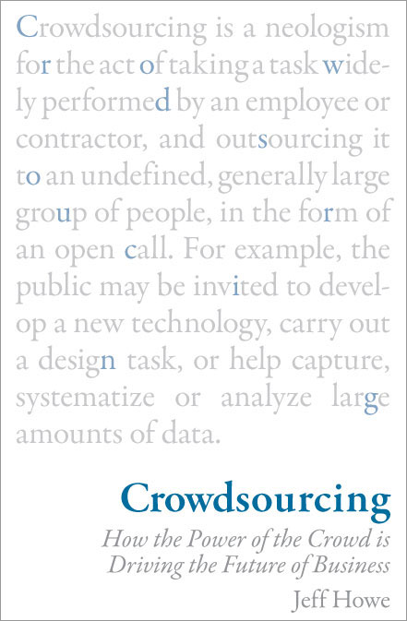

Slide 6
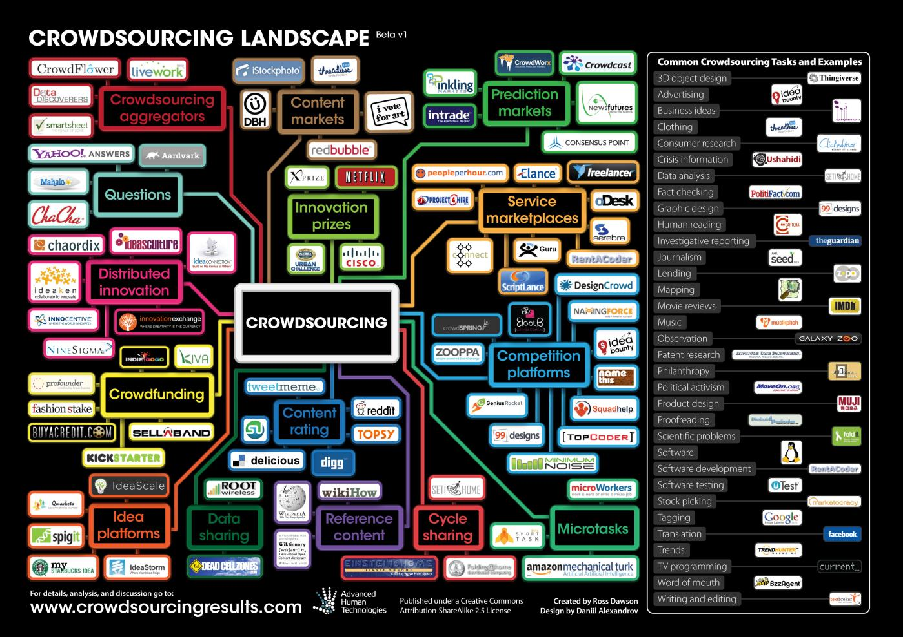
http://crowdsourcingresults.com/

Slide 7
myPersonality – Global Psychometrics Research on Facebook

Slide 8
TrueSkill Ranking and Matchmaking for Xbox Live Online Gaming
Herbrich, Minka, Graepel, TrueSkill: A Bayesian Skill Rating System, NIPS, 2006

Slide 9
Project Emporia – Harvesting and Recommending Stories from Twitter
www.projectemporia.com FUSE, UK, MSR Cambridge

Slide 10
Fold.it - Protein Folding Game to Engage Crowd in Research

Slide 11
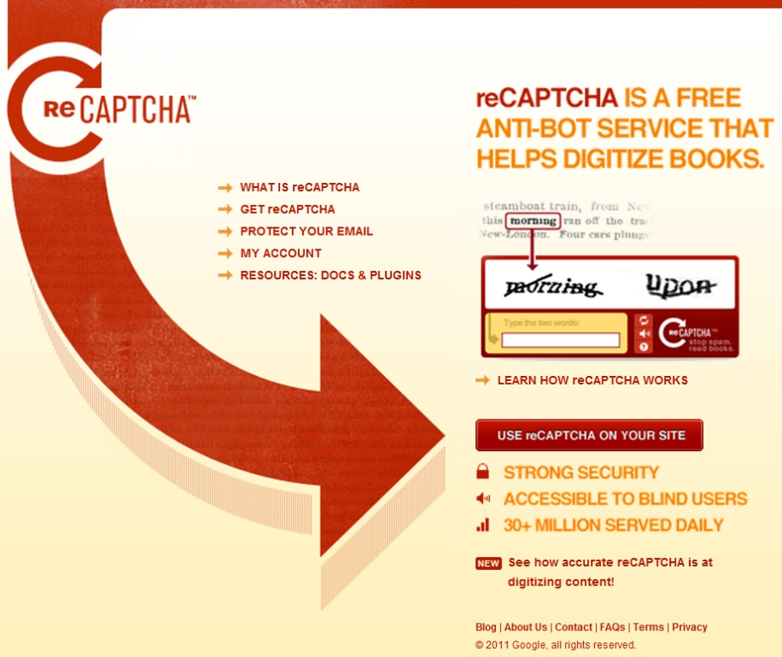
reCaptcha: An Automated Turing Test Helps Digitizing Old Books

Slide 12
RoboEarth – Wikipedia for Robots (Skynet Version 1.0)

Slide 13
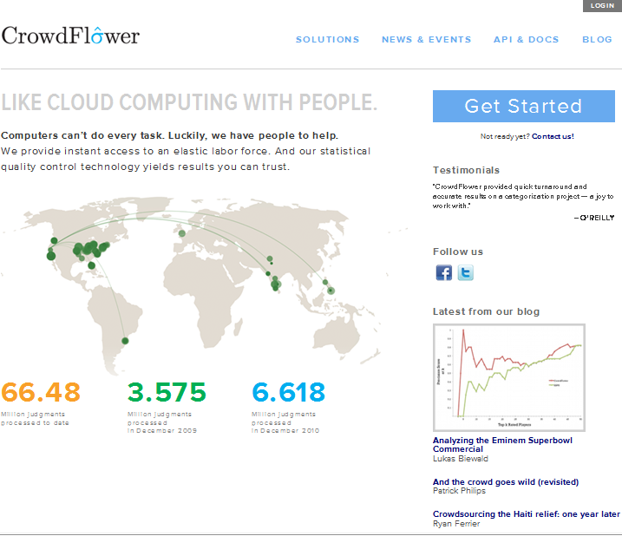
Mechanical Turk/Crowdflower – Artificial Artificial Intelligence

Slide 14
A Taxonomy of Distributed Human Computation (Quinn & Bederson, 2009)
Genre
Games with a purpose, Mechanized labour, Wisdom of crowds, Crowdsourcing, Dual-purpose work, Grand search, Human-based genetic algorithms, Knowledge collection from volunteer contributors
Motivation
Pay (Fortune), Altruism (Fulfilment), Fun, Implicit, +Fame
Quality
Forced agreement, Economic model, Defensive task design, Redundancy (flat, hierarchical), Reputation system
Other
Human skill, participation time, cognitive load

Slide 15
Human-Machine Learning Systems
Combine Machine Learning and Crowdsourcing
Use crowdsourcing to generate training examples or labels for a given task
Use Machine Learning to learn models/predictors from training examples
Use models/predictors to perform task at scale
Examples:
Automatic labelling of news stories
Judging of query/url pairs of search results

Slide 16
Overview
Crowdsourcing
Examples and Distinctions
Active Learning
Which tasks to solve?
Knowledge Corroboration
How to combine answers?
Crowd Psychometrics
How smart is the crowd?

Slide 17
Active Learning
Instead of a fixed data set we are given an “oracle” that labels data at a cost
Select optimal labelling strategy given
Cost of a label
Marginal value of a label
Required accuracy
Dynamics of the data

Slide 18
Active Learning (McKay, 1992)
Prediction task with data $D_{N}=\{x_{m},y_{m}\}$
Specify prior $p(w)$ and likelihood $p(y|x,w)$
Use Bayes’ Law to obtain posterior $p_{N}(w)≔p(w|D_{N})$ after $N$ data points
Post. entropy: $S_{N}≔∫p_{N}\left(w\right)\log{\frac{m(w)}{p_{N}\left(w\right)}dw}$
Select next data point $x^{∗}$ to maximise $E\left[ΔS \left(x\right)\right]≔E[S_{N}−S_{N+1}(x)]$

Slide 19
Active Learning Illustration
$$x_{3}$$
$$p(w)$$
$$x_{1}$$
$$x_{2}$$

Slide 20
Active Filtering
Optimal active learning to identify best subset of size $k$ of $N$examples is intractable
Optimal active learning to identify best subset of size 𝑘 of 𝑁 examples is intractable
Even greedy active learning requires $O(Nk)$ operations and is computationally costly
Even greedy active learning requires O(𝑁𝑘) operations and is computationally costly
In Practice: Filter on an entropy related criterion and decide for each example if it becomes part of the next batch to be sent to the labelling oracle
Also see Ulrich Paquet, Jurgen Van Gael, David Stern, Gjergji Kasneci, Ralf Herbrich, and Thore Graepel, Vuvuzelas & Active Learning for Online Classification, in Computational Social Science and the Wisdom of Crowds Workshop

Slide 21
RSS feeds Stories from Twitter
http://tirania.org/blog/archive/2010/aug-03.html
MonoTools 2 for VisualStudio has been released
We just released Mono Tools for Visual Studio.
2010-08-03 19:21:00.000
http://www.nytimes.com/2010/08/04/science/space/04nasa.html
News Analysis: As Space Priorities Shift, Orbiting Station Takes On a Central Role
If the International Space Station were ever abandoned, the United States’ human spaceflight program would lose one of its last remaining reasons for being.
2010-08-04 06:10:03.000
http://www.thatsfit.com/2010/08/27/stars-favorite-pilates-moves-to-lose-baby-weight/
The Best Pilates Moves for Losing Baby Weight
Bryan Bedder, Getty Images for Tribeca Film Festival August is one of the biggest birth months.
2010-08-27 14:00:00.000
We have a budget to get a fixed number of these labelled ...
time
... then ...
http://www.engadget.com/2010/11/17/verizons-redzone-channel-streaming-fios-football-app-for-ipad-s/
Verizon's RedZone Channel-streaming FiOS Football app for iPad shows up on iTunes (again)
Though the FiOS Football app for iPad only showed up on the App Store for a short time a couple of weeks ago, it was long enough for us to fall in love with having access to RedZone Channel video and stats in our laps while keeping the TV tuned to one key game.
2010-11-17 10:14:00.000
... what is the probability that this story is about technology? (or some class)
Notes:
In a nutshell: We have a database of 100K time-stamped articles, pulled from many RSS feeds (they are all classified). I made the assumption that
The first 50K stories / articles are going to run past us;
We want to make some decent future predictions (on the second 50K – they are time-stamped so simulate in some way the non-i.i.d. process of events happening in the world);
We have a budget to pay for 2K articles to get labelled;
Labelling happens online – as we see articles, they are shipped out to MT.
There are three pages:
Vanilla – just picking the first 2K that we see;
Selective – with some basic information-based heuristics;
All training data – what we would get if all 50K stories were labelled.
I used the model that we currently use for Emporia (two bags of words for the title / description summary header).

Slide 22
Labelling
http://tirania.org/blog/archive/2010/aug-03.html
MonoTools 2 for VisualStudio has been released
We just released Mono Tools for Visual Studio.
2010-08-03 19:21:00.000
http://www.nytimes.com/2010/08/04/science/space/04nasa.html
News Analysis: As Space Priorities Shift, Orbiting Station Takes On a Central Role
If the International Space Station were ever abandoned, the United States’ human spaceflight program would lose one of its last remaining reasons for being.
2010-08-04 06:10:03.000
50K, of which there is a budget to label 2K
http://www.thatsfit.com/2010/08/27/stars-favorite-pilates-moves-to-lose-baby-weight/
The Best Pilates Moves for Losing Baby Weight
Bryan Bedder, Getty Images for Tribeca Film Festival August is one of the biggest birth months.
2010-08-27 14:00:00.000
time
Title: News Analysis: As Space Priorities Shift, Orbiting Station Takes On a Central Role
Summary: If the International Space Station were ever abandoned, the United States’ human spaceflight program would lose one of its last remaining reasons for being.
Test on
50K new stories
x = (bag of title words, bag of summary words)
p(story about technology | x) = ?
(sparse-feature probit model)

Slide 23
Active Learning Results
 | Accuracy | True positive rate | False positive rate
All 50k articles | 93.977% | 78.531% | 2.107%
First 2k articles | 96.198% | 25.331% | 1.395%
Random sample 2k articles | 92.236% | 76.957% | 3.891%
Selective Labelling | 92.240% | 77.208% | 3.950%
Selection heuristic: $|p_{N}\left(y | x\right)−0.5|$<0.15
Very dynamic topic distribution makes it important to sample across the entire time span of data
Selective sampling does not buy us much in this dynamic environment
Requires further investigation

Slide 24
Overview
Crowdsourcing
Examples and Distinctions
Active Learning
Which tasks to solve?
Knowledge Corroboration
How to combine answers?
Crowd Psychometrics
How smart is the crowd?

Slide 25
Knowledge Corroboration
Given answers to the same question from a number of sources, how can we best combine those answers?
Voting?
Voting weighted by track-record of source?
Voting weighted by track-record of source for that particular type of question?
Incorporate logical constraints between the answers?
Use principled Bayesian reasoning framework

Slide 26
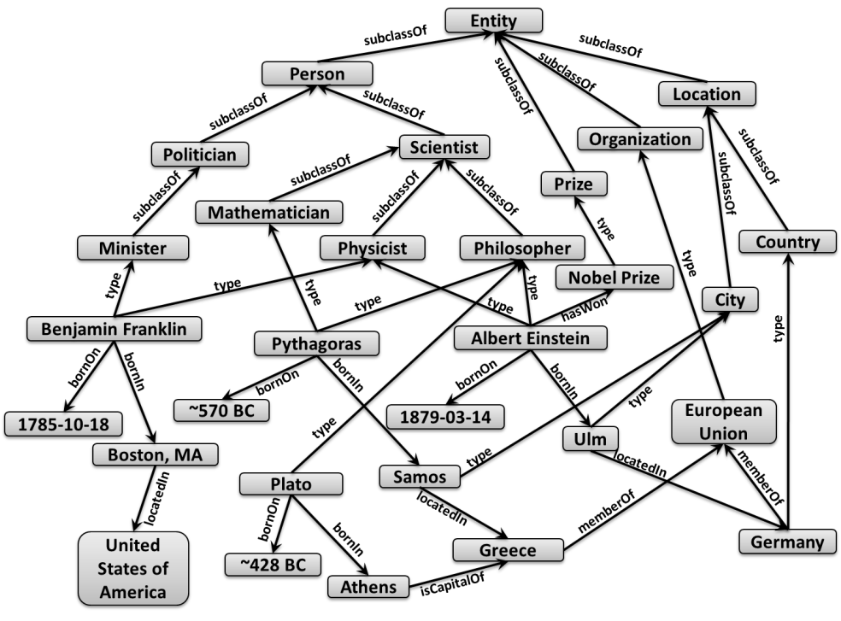
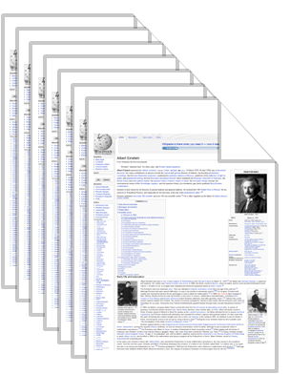
Semantic & Social Web
???
Examples:
Wikipedia
IMDB
DBLP
Knowledge Base
Extraction
& Integration:
Lexicons
Regular expressions
Pattern matching
Statistical learning
Examples:
DBpedia
YAGO
LOD
Creation &
Annotation:
Intelligence
Wisdom

Slide 27
Knowledge Corroboration
Integrate opinions to
learn truth values
???
Trace uncertainty
and use deduction rules
to learn reliabilities
Knowledge Base
Problems:
Low accuracy
Low coverage
w.r.t. entities
w.r.t. relationships
Problems:
Inconsistency
Disagreement
Ignorance
Maliciousness

Slide 28
Knowledge Representation: From RDFS to RDFS#
Scientist
<AlbertEinstein, type, Physicist>˄<Physicist, subClassOf, Scientist>
→ <AlbertEinstein, type, Scientist>
<AlbertEinstein, type, Philosopher>˄<Philosopher, subClassOf, Scientist>
→ <AlbertEinstein, type, Scientist>
Note: In any RDFS# knowledge base, in which p(f)=1 for all f,
we have logical consistency if and only if there is no cycle
along a deduction path.
subClassOf
subClassOf
Physicist
type
Philosopher
type
type
Albert Einstein

Slide 29
Knowledge Representation: RDFS#
0.9
0.96
Scientist
<AlbertEinstein, type, Physicist>˄<Physicist, subClassOf, Scientist>
→ <AlbertEinstein, type, Scientist>
<AlbertEinstein, type, Philosopher>˄<Philosopher, subClassOf, Scientist>
→ <AlbertEinstein, type, Scientist>
Probabilistic Consistency: When there exist truth values, such
that all groundings of the deductions are satisfied.
Example: Consider all premises to a conclusion C
(A₁ ˄ B₁)→ C ˄ … ˄ (A_{d} ˄ B_{d})→ C is true
(A₁ ˄ B₁) ˅ … ˅ (A_{d} ˄ B_{d}) → C is true
(A₁ ˄ B₁) ˅ … ˅ (A_{d} ˄ B_{d}) ˅ D = C is true,
where D is the missing evidence
0.86
0.84
0.96
subClassOf
subClassOf
0.8
Physicist
type
Philosopher
type
type
Albert Einstein

Slide 30
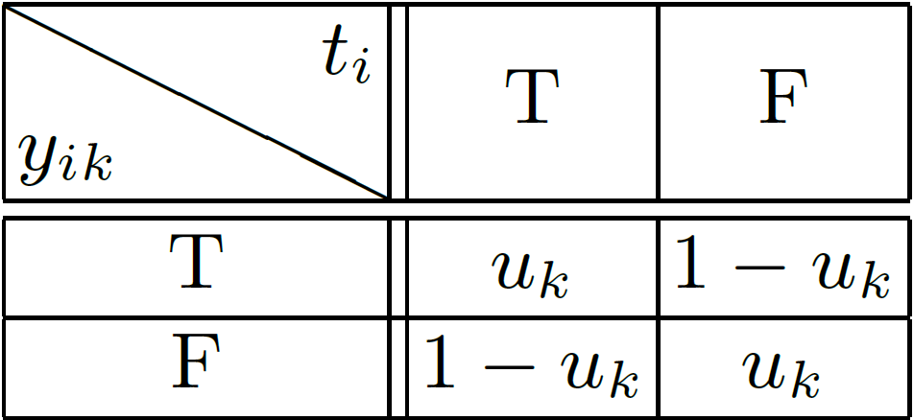
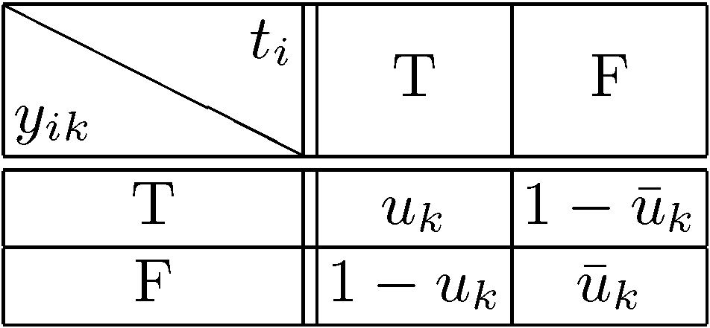
Probabilistic Models for RDFS# and User Feedback
Modelling User Behaviour
1-Parameter feedback model
2-Parameter feedback model
t_{i}
y_{ik}
t_{i}
y_{ik}
i=1,..., n
i=1,..., n
u_{k}
u_{k}
u_{k}
k=1,..., m
k=1,..., m

Slide 31
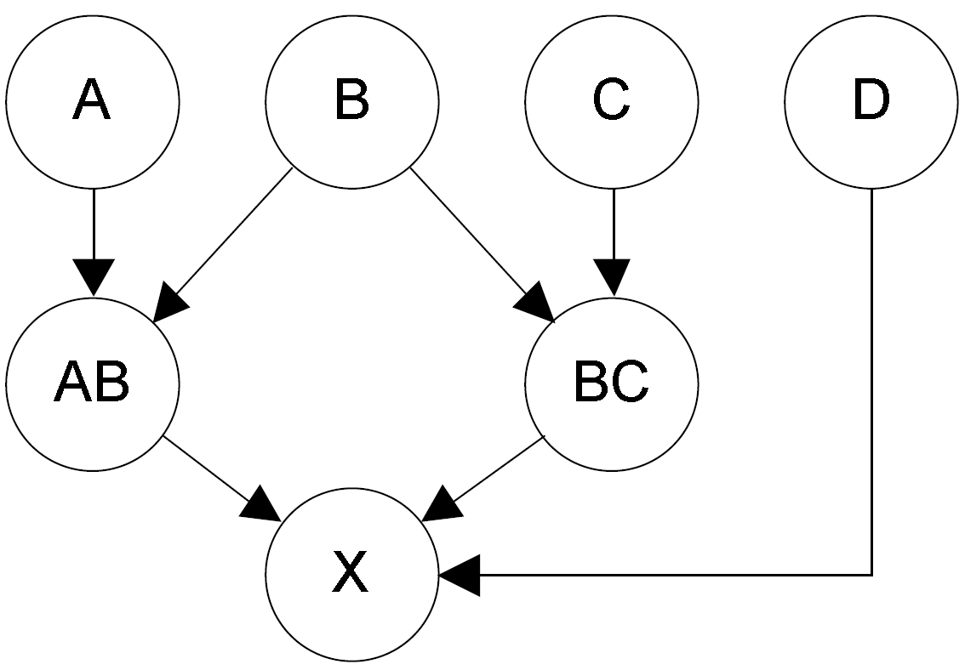
Probabilistic Models for RDFS# and User Feedback
Modelling Derived Facts
Scientist
subClassOf
˄
˄
subClassOf
Physicist
type
Person
˅
type
type
X = (A ˄ B) ˅ (B ˄ C) ˅ D = AB ˅ BC ˅ D
Albert Einstein
Deduced Facts Prior:
to account for
incomplete knowledge

Slide 32
Probabilistic Models for RDFS# and User Feedback
Four Different Models
Model Name | Composition
I1 | 1-parameter feedback model
I2 | 2-parameter feedback model
D1 | Deduced facts prior & 1-prameter feedback model
D2 | Deduced facts prior & 2-parameter feedback model
y_{i1}
y_{i2}
y_{j1}
y_{j2}
u₁
u₂
Composition of probabilistic models for
user feedback
Feedback propagation for an instance of
the D1 model.

Slide 33
Probabilistic Inference
The inference problem consists of inferring the marginal probability distributions over:
Truth values $t_{i}$
Truth values 𝑡_𝑖
User reliabilities $u_{k}$
User reliabilities 𝑢_𝑘
We use approximate message passing (loopy belief propagation
User feedback → Very efficient inference
Logical dependencies → much less efficient

Slide 34
Experimental Evaluation
833 interlinked facts about prominent scientists from YAGO
271 randomly generated facts from YAGO entities and relations
Deductive closure resulted in 329 pairs of facts that imply another fact
True/False labels were collected from Amazon Mechanical Turk (AMTurk)
111 AMTurk users were presented tasks of 5 facts each (10 US cents per task)
Each user completed between 1 and 186 tasks
Total number of feedback labels 11,031
Includes transitive relationships, e.g., isA, influences, locatedIn

Slide 35
Experimental Evaluation
Results: negative log score as a function of the number of user assessments
I1
I2
D1
D2

Slide 36
AMT Worker Analytics
Results: users represented by their u and ū (for the D2 model)
For details see Gjergji Kasneci, Jurgen V. Gael, Ralf Herbrich, and Thore Graepel, Bayesian Knowledge Corroboration with Logical Rules and User Feedback, in ECML PKDD, 2010

Slide 37
How about the Expertise
Reliabilities of users will vary across questions depending on the specific expertise
Use collaborative filtering style system to model user expertise
Use modularity of graphical models to combine recommender system module with user feedback model and logical inference

Slide 38
Matchbox: Features To ‘Trait’ Space
234566
34
456457
User ID
345
Fact ID
13456
64
654777
5474
Male
Gender
Science
Female
History
Fact Type
UK
Politics
Country
USA
Entertainment
IQ
110
Matchbox: Large Scale Bayesian Recommendations, WWW 2009

Slide 39
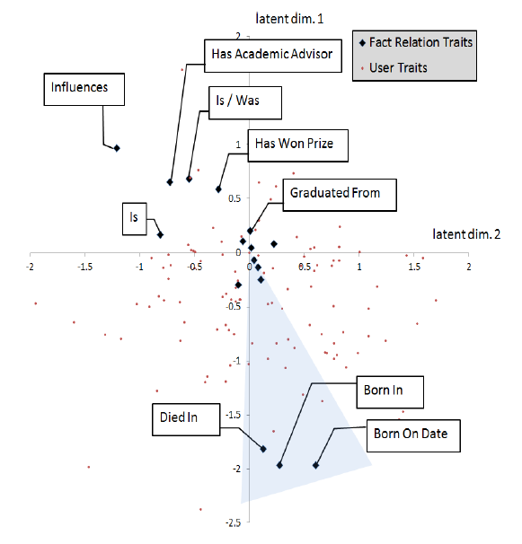
User/Fact Expertise Space

Slide 40
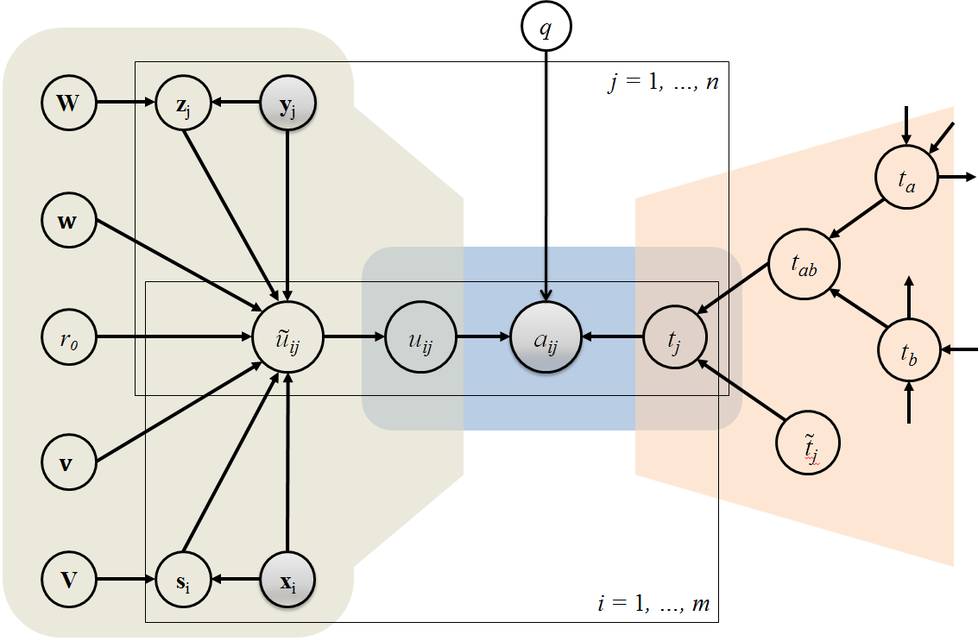
Modular Graphical Model based on Matchbox Recommender System
Feature-based feedback model

Slide 41
Results for Expertise Model
all fact and user features
All + transitivity
all fact features except ID
MB2 + transitivity

Slide 42
Conclusions Knowledge Corroboration
Powerful combination of machine learning and human labour can help curate knowledge bases
Jointly estimating truth values of facts and reliability of users leads to better results
Modularity of probabilistic graphical models provides powerful machine learning toolbox
CoBayes: Bayesian Knowledge Corroboration with Assessors of Unknown Areas of Expertise, Kasneci, Van Gael, Stern, Graepel, WSDM 2011

Slide 43
Overview
Crowdsourcing
Examples and Distinctions
Active Learning
Which tasks to solve?
Knowledge Corroboration
How to combine answers?
Crowd Psychometrics
How smart is the crowd?

Slide 44
How smart is the crowd?
If we view AMT as a black box “Artificial Artificial Intelligence”, how intelligent is it?
Can we apply a standard IQ test such as Raven’s Progressive Matrices (1938)?
How do different parameters such as payment, batch size, track-record, and HIT design influence measured IQ?
How can we best aggregate the results?

Slide 45
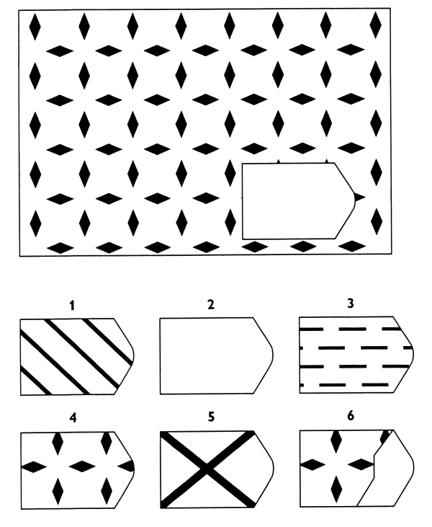
Raven’s Progressive Matrices
Multiple Choice IQ test
Best known correlation with g-score.
Well standardised/ calibrated against wide population
Easy to deliver via web interface

Slide 46
Average IQ for Different Payments
Above average values for all conditions
self-selection
Sweet spot at 0.05 USD
Different motivation
Different composition of work force
We chose 0.05 USD for follow-on experiments
Payment in USD | Average IQ
0.01 | 110
0.05 | 125
0.10 | 115
0.20 | 110

Slide 47
IQ for Majority Voted AMT
Note that only 1 in 1000 of the population has an IQ greater or equal 145.

Slide 48
Conclusions
Distributed human computing provides powerful new module of computation
Hybrid human-computer systems make it possible to bring human intelligence to web scale
How can we use the scarce resource of human intelligence most efficiently?
How can we use redundancy to improve accuracy?
How intelligent can such hybrid systems be?

