Slide 1
An Analysis of Assessor Behavior in Crowdsourced Preference Judgments
Dongqing Zhu and Ben Carterette
University of Delaware

Slide 2
Objective
Analysis of assessor behavior in our pilot study to determine the optimal placement of images among search results
Identify some patterns that may be broadly indicative of unreliable assessments
Inform future experimental design and analysis when using crowdsourced human judgments

Slide 3
Description of Our Pilot Study
Objective: determine the optimal placement of images among search results
Objects to be assessed: full page layouts consisting of both ranked results and results from image search verticals

Slide 5
Description of Our Pilot Study
Method: preference judgments
pros:
can be made quickly
less prone to disagreements between assessors
more robust to missing judgments
correlate well to traditional evaluation measures based on absolute relevance judgments on documents
can be mapped to much finer-grained grades of utility
cons:
number of pairs grows quadratically
number of objects grows factorially
unreliable data

Slide 6
Experimental Design
Platform:
Amazon Mechanical Turk HIT (Human Intelligent Task) question → our own survey website, which allows us to show each MTurker a sequence of survey questions and to log additional information such as IP address, time-on-task, etc..
US$0.13 for every 17 survey questions.

Slide 7
Experimental Design
Survey Website:
A simple question at the beginning of the survey to identify a user's favorite search engine
Then a sequence of 17 full-page preferences
each preference was for a different query
order of queries randomized
Confirmation code at the end to be submitted via HIT

Slide 8
Experimental Design
Each survey question has two tasks
Full Page Layouts Preference Judgments Task
Preferences on variations of the Yahoo! SERP layout for 47 queries formed from 30 topics taken from the TREC 2009 Web track and the TREC 2009 Million Query track
Absolute-scale Image Rating Task
rate the pictures by relevance on a ternary scale (“poor”, “OK”, “good”).

Slide 9
Experimental Design
Full Page Layouts Preference Judgments Task
Full page layouts consisted of ranked results plus
inline images to the left or right of summaries
image search vertical results on the top, middle, or bottom of page
Up to 6 variant layouts possible
2 of 17 queries are “trap” questions
two identical result pages
placed at 6th and 15th in the sequence

Slide 10
Data Analysis
So far we have had
48 approved HITs (36-Google, 11-Yahoo, 1-Bing)
20 rejected HITs (15-G, 3-Y, 1-Bing, 1-Ask)
Rejection Criteria: Failure on the trap question.

Slide 11
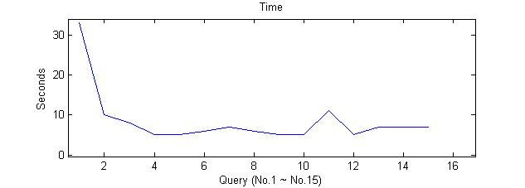
Analysis of Approved Data
Time analysis
Normal pattern: the assessor starts out slow, quickly gets faster as he or she learns about the task, and then roughly maintains time.
37 out of 48 assessors (77%) fall into this category

Slide 12
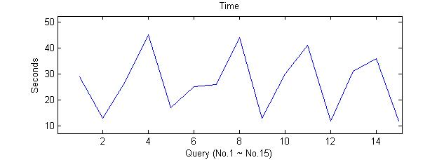
Analysis of Approved Data
Time analysis
Periodic or Quasi-periodic pattern: some judgments are made fast and some are made slow, but the fast and slow tend to alternate.
One possible explanation: absent-minded periodically
7 out of 48 assessors (15%) fall into this category
Notes:
instant messaging browser blur

Slide 13
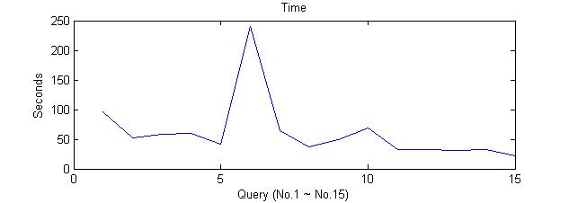
Analysis of Approved Data
Time analysis
Interrupted pattern: occasional peaks appears under the background of Normal pattern.
4 out of 48 assessors (8%) fall into this category

Slide 14
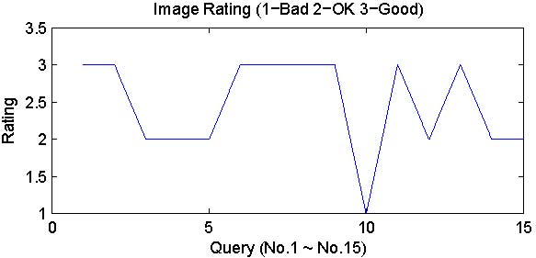
Analysis of Approved Data
Image rating analysis
Normal pattern: Users give rating 2 or 3 most often and give rating 1 occasionally.
34 out of 48 assessors (71%) fall into this category

Slide 15
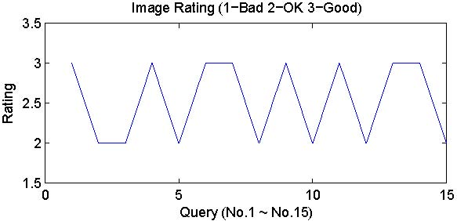
Analysis of Approved Data
Image rating analysis
Periodic or Quasi-periodic pattern: a user shows a tendency to alternate between a subset of ratings
8 out of 48 assessors (17%) fall into this category

Slide 16
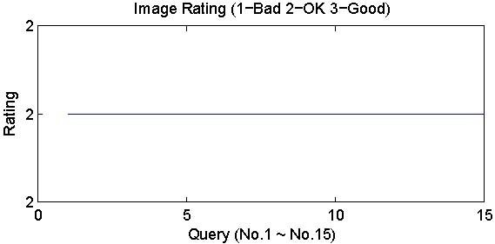
Analysis of Approved Data
Image rating analysis
Fixed pattern: all or most of the images rating are the same.
6 out of 48 assessors (12%) fall into this category

Slide 17
Analysis of Approved Data
Preference judgment analysis
We analyze preference judgments for the mixed set (both inline and vertical image results) to determine whether we can identify one or the other as the primary factor in the assessor's preference.

Slide 18
Analysis of Approved Data
Preference judgment analysis
We separately analyzed the inline placement and vertical placement preferences for the time being. We assign TMB (top/middle/bottom vertical variants) and LR (left/right inline variants) scores to indicate the layout preferences according to the following method:
Given a T-B pair, if the user prefers T, we assign 1.5 as TMB score of that pair. Otherwise, we assign -1.5.
Given an M-B pair, if the user prefers M, we assign 1 as TMB score of that pair. Otherwise, we assign -1.
Given a T-M pair, if the user prefers T, we assign 1 as TMB score of that pair. Otherwise, we assign -1.
Given an L-R pair, if the user prefers L, we assign 1 as LR score of that pair. Otherwise, we assign -1.

Slide 19
Analysis of Approved Data
Preference judgment analysis
Layout preference curves: moving averages of the TMB and LR scores (red and blue lines, respectively) against query number. Window size equals to 5.
There are roughly two patterns of layout preference curves: either only one of the scores changes over time, or both do.

Slide 20
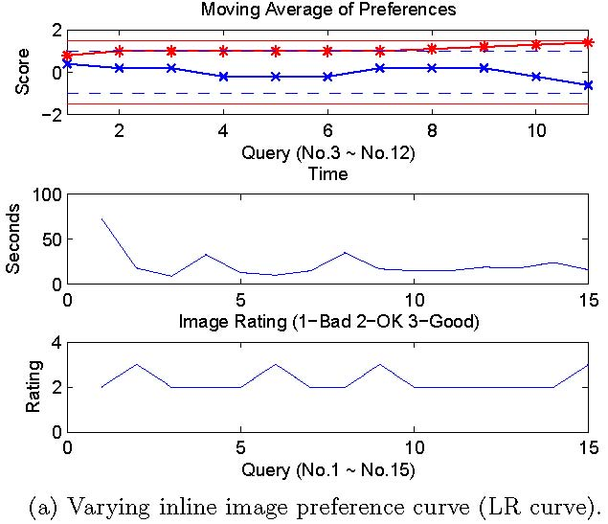
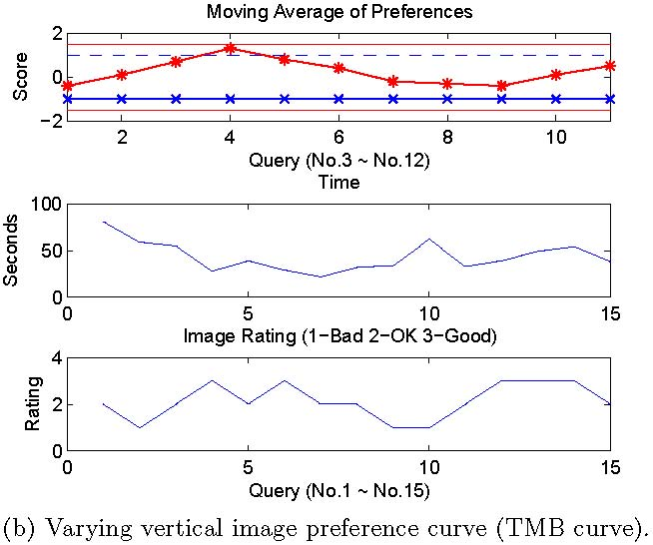
Analysis of Approved Data
Preference judgment analysis
Only one of the scores changes over time. We infer from this that it is the layout preference associated with the varying curve that is the leading factor in making preferences. 21/48 (44%) assessors showed this pattern.

Slide 21
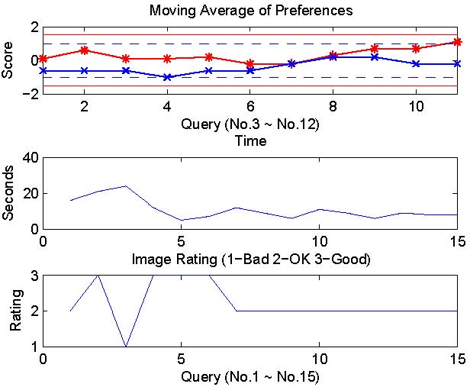
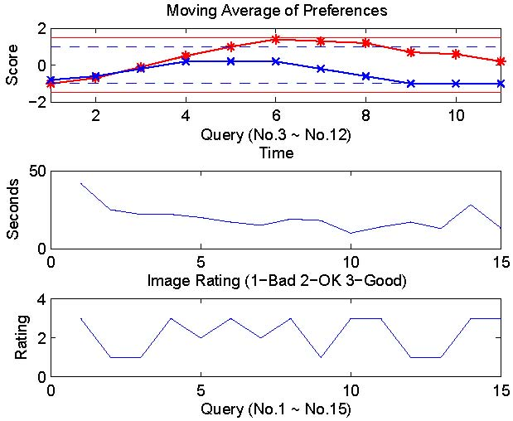
Analysis of Approved Data
Preference judgment analysis
Both TMB and LR curves vary over time. We may need to look at each SERP pair individually to determine if TMB and LR positions have a combinational effect on layout preference. 27/48 (56%) assessors showed this pattern.

Slide 22
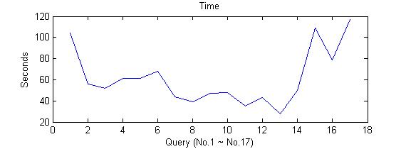
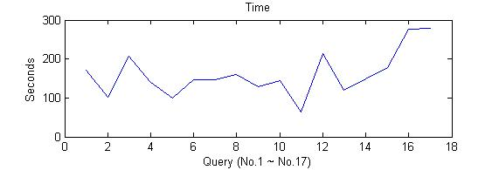
Analysis of Rejected Data
Analysis of Rejected Data
14/20 (70%) exhibited unusual behavior patterns
4 showed an abnormal time pattern of taking longer on the last few queries; this was not observed among assessors that passed the trap questions.

Slide 23
Analysis of Rejected Data
Analysis of Rejected Data
2 showed an interrupted time
4 showed a fixed image rating pattern, 1 of them also showed an interrupted time pattern
4 showed a quasi-periodic image rating pattern, 1 of them also showed a quasi-periodic time pattern

Slide 24
Conclusion
Turkers prefer
vertical image results near the top of the page
inline image results on the left

Slide 25
Conclusions
Unreliable assessors detectable
periodic timings
abnormal timings
periodic ratings
fixed ratings
Assessors may be reliable on one task but unreliable for another
Trap questions are useful
Trap questions in conjunction with timings/ratings filters best
MTurkers learning how to avoid being detected when cheating

Slide 26
Acknowledgements

Slide 27
Q&A

